Slide 1
Topic:-
Symmetric Cipher Model, Substitution techniques, Transposition techniques, Steganography

Slide 2
Symmetric Cipher Model
A symmetric encryption scheme has five ingredients:
Plaintext: original message to be encrypted.
Ciphertext: the encrypted message.
Encryption algorithm: The encryption algorithm performs various substitutions and transformations on the plaintext.
Decryption algorithm: This is essentially the encryption algorithm run in reverse. It takes the ciphertext and the secret key and produces the original plaintext.
Secret key: A secret key is the piece of information or parameter that is used to encrypt and decrypt messages in a symmetric, or secret-key, encryption.

Slide 3
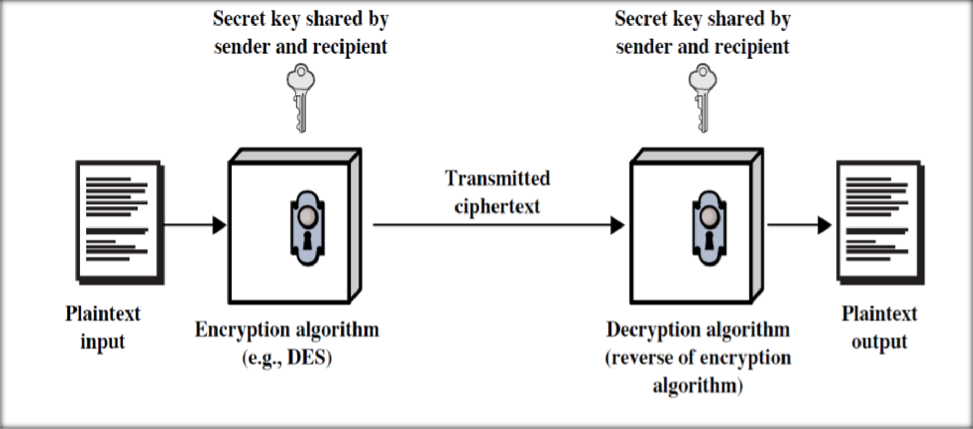
Simplified Model of Symmetric encryption

Slide 4
There are two requirements for secure use of symmetric encryption:
a strong encryption algorithm.
a secret key known only to sender / receiver.

Slide 5
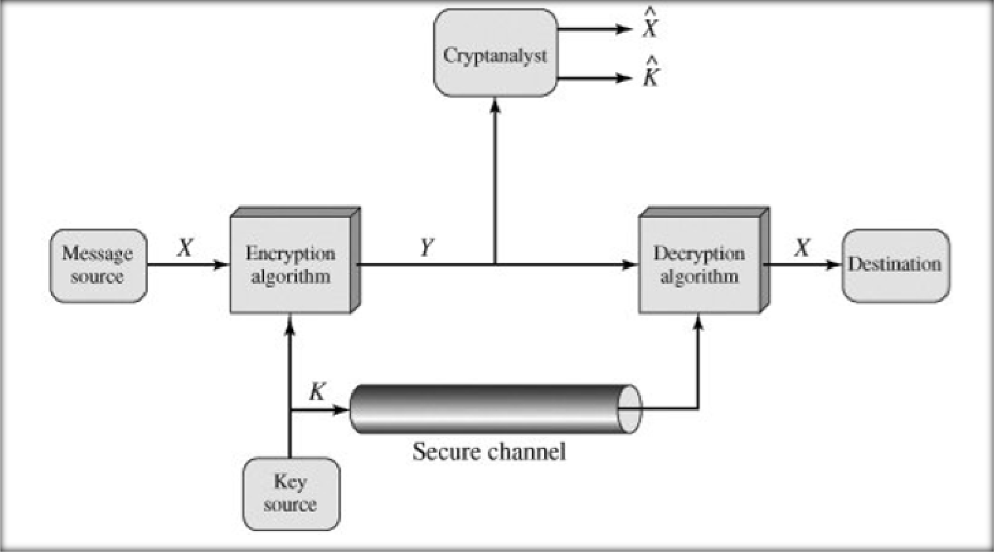
Model of Conventional Cryptosystem

Slide 6
Symmetric Encryption
Mathematically:
Y = EK(X) or Y = E(K, X) X = DK(Y) or X = D(K, Y)
X = plaintext
Y = ciphertext
K = secret key
E = encryption algorithm
D = decryption algorithm
Both E and D are known to public

Slide 7
Cryptography
Cryptographic systems are characterized along three independent dimensions:
The type of operations used for transforming plaintext to ciphertext.
The number of keys used.
The way in which the plaintext is processed.

Slide 8
Cryptanalysis
Cryptanalytic attacks rely on the nature of the algorithm plus perhaps some knowledge of the general characteristics of the plaintext or even some sample plaintext–ciphertext pairs. This type of attack exploits the characteristics of the algorithm to attempt to deduce a specific plaintext or to deduce the key being used.
Kirchhoff's principle: the adversary knows all details about a cryptosystem except the secret key.
Two general approaches:
brute-force attack
non-brute-force attack (cryptanalytic attack)

Slide 9
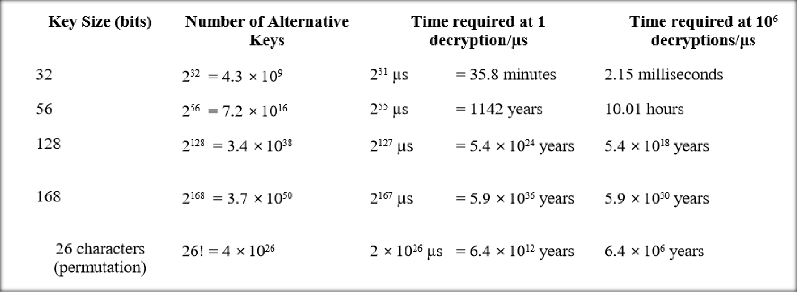
Brute-force attack:
The attacker tries every possible key on a piece of ciphertext until an intelligible translation into plaintext is obtained. On average, half of all possible keys must be tried to achieve success.

Slide 10
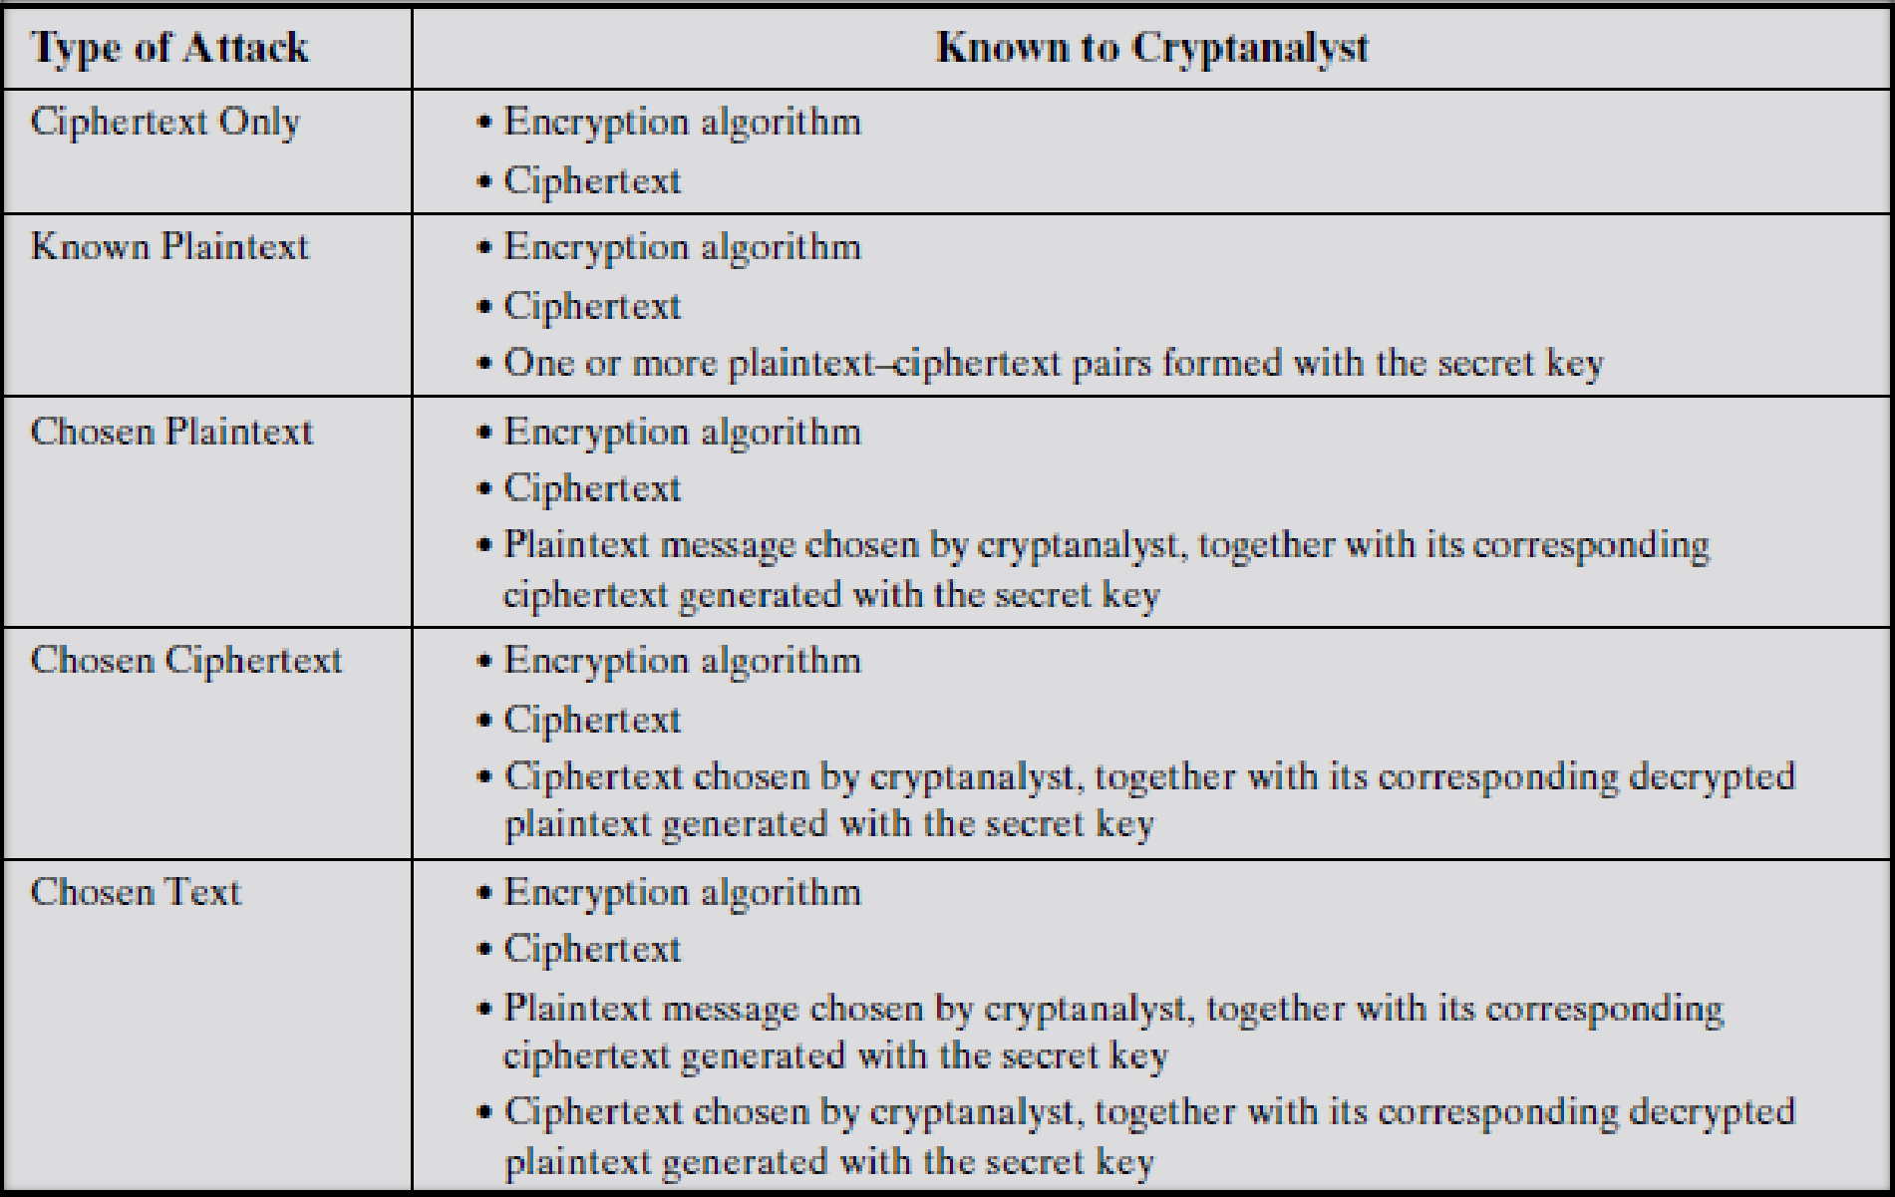
Cryptanalytic Attacks

Slide 11
Unconditional Security
An encryption scheme is unconditionally secure if the ciphertext generated by the scheme does not contain enough information to determine uniquely the corres-ponding plaintext, no matter how much ciphertext is available.
Therefore, all that the users of an encryption algorithm can strive for is an algorithm that meets one or both of the following criteria:
The cost of breaking the cipher exceeds the value of the encrypted information.
The time required to break the cipher exceeds the useful lifetime of the information.
An encryption scheme is said to be computationally secure if either of the foregoing two criteria are met.

Slide 12
Basic Terminology
plaintext - the original message
ciphertext - the coded message
cipher - algorithm for transforming plaintext to ciphertext
key - info used in cipher known only to sender/receiver
encipher (encrypt) - converting plaintext to ciphertext
decipher (decrypt) - recovering ciphertext from plaintext
cryptography - study of encryption principles/methods
cryptanalysis (codebreaking) - the study of principles/ methods of deciphering ciphertext without knowing key
cryptology - the field of both cryptography and cryptanalysis

Slide 13
Cryptosystem
A cryptosystem is a five-tuple (P,C,E,D), where the following are satisfied:
p is a finite set of possible plaintexts.
C is a finite set of possible ciphertexts.
K, the key space, is a finite set of possible keys
E_{K} (encryption rule),
D_{K}(decryption rule).
Each E_{K}: P->C and D_{K}: C->P are functions
such that , D_{K}(E_{K}(x)) = x.

Slide 14
The two basic building blocks of all encryption techniques are :
1. Substitution techniques: A substitution technique is one in which the letters of plaintext are replaced by other letters or by numbers or symbols. If the plaintext is viewed as a sequence of bits, then substitution involves replacing plaintext bit patterns with ciphertext bit patterns.
Different types of Substitution techniques are:
Caesar Cipher
Monoalphabetic Ciphers
Playfair Cipher
Hill Cipher
Polyalphabetic Ciphers
One-Time Pad

Slide 15
Caesar Cipher
The Caesar Cipher technique is one of the earliest and simplest method of encryption technique. It’s simply a type of substitution cipher, i.e., each letter of a given text is replaced by a letter some fixed number of positions down the alphabet. The method is apparently named after Julius Caesar, who apparently used it to communicate with his officials.
Example, key=3
plaintext: hello how are you ciphertext: KHOOR KRZ DUH BRX

Slide 16
Caesar Cipher
can define transformation as:
a b c d e f g h i j k l m n o p q r s t u v w x y z D E F G H I J K L M N O P Q R S T U V W X Y Z A B C
mathematically give each letter a number
a | b c | d | e f | g | h i | j | k | l | m
0 | 1 2 | 3 | 4 5 | 6 | 7 8 | 9 | 10 | 11 | 12
n | o | p | q | r | s | t | u | v | w x y Z
13 14 15 16 17 18 19 20 21 22 23 24 25
^{λ} then have Caesar cipher as:
C = E(p) = (p + k) mod (26)
p = D(C) = (C – k) mod (26)

Slide 17
Monoalphabetic Ciphers
Better than Caeser Cipher
For each character of alphabet, assign different-abrupt concerned character
Example:
a | b | c | d | e | f | g | h | i | j | k | l | m | n | o | p | q | r | s | t | u | v | w | x | y | z
Z | Y | X | W | V | U | T | S | R | Q | P | O | N | M | L | K | J | I | H | G | F | E | D | C | B | A
Monoalphabetic ciphers are easy to break because they reflect the frequency data of the original alphabet.
A countermeasure is to provide multiple substitutes, known as homophones, for a single letter. If two letters considered for substitutes it is called as digrams.
For Example: A-Plaintext: goodmorning
Ciphertext: TLLWNLIMRMT

Slide 18
Playfair Cipher
The best-known multiple-letter encryption cipher is the Playfair, which treats diagrams in the plaintext as single units and translates these units into ciphertext diagrams.
The Playfair algorithm is based on the use of a 5 * 5 matrix of letters constructed using a keyword.
For Example,
Keyword: security (monarchy)
Plaintext: pattern
In this case, the keyword is security. The matrix is constructed by filling in the letters of the keyword (minus duplicates) from left to right and from top to bottom, and then filling in the remainder of the matrix with the remaining letters in alphabetic order.
Note: The letters I and J count as one letter.

Slide 19
Plaintext is encrypted two letters at a time, according to the following rules: BALLOON=> BA LX L0 ON
S | E | C | U | R
I/J | T | Y | A | B
D | F | G | H | K
L | M | N | O | P
Q | V | W | X | Z
Repeating plaintext letters that are in the same pair are separated with a filler letter, such as x, so that pattern would be treated as pa tx te rn.
Two plaintext letters that fall in the same row of the matrix are each replaced by the letter to the right, with the first element of the row circularly following the last. For example, op is encrypted as PL.
Two plaintext letters that fall in the same column are each replaced by the letter beneath, with the top element of the column circularly following the last. For example, mv is encrypted as VE.

Slide 20
4) Otherwise, each plaintext letter in a pair is replaced by the letter that lies in its own row and the column occupied by the other plaintext letter. Thus, pa becomes OB.
Plaintext: pa tx te rn Ciphertext: OB VA FT CP
The Playfair cipher is a great advance over simple monoalphabetic ciphers.
For one thing, whereas there are only 26 letters, there are 26 * 26 = 676 diagrams, so that identification of individual diagrams is more difficult.

Slide 21
Hill Cipher
This encryption algorithm takes m successive plaintext letters and substitutes for them m ciphertext letters.
The substitution is determined by m linear equations in which each character is assigned a numerical value.
a | b | c | d | E | F | g | h | i | j | k | l | m | n | o | p | q | r | s | t | u | v | w | x | y | z
0 | 1 | 2 | 3 | 4 | 5 | 6 | 7 | 8 | 9 | 10 | 11 | 12 | 13 | 14 | 15 | 16 | 17 | 18 | 19 | 20 | 21 | 22 | 23 | 24 | 25
In general terms , the hill system can be expressed as, C=E(P,K)=PKmod26
P=D(C,K)=C𝐾⁻¹mod26

Slide 22
Example
Plaintext: abcd
1
5 2
1 2 −1 ₌
𝑎c − 𝑏𝑑 ⁵
2 −1
5 3
Keyword: ³
_{𝑘}−1 ₌
3
C=E(P,K)=PKmod26
P=D(C,K)=C𝐾⁻¹mod26
1
2 3
5
21 8
5 2
21 8
5 2 2
21 8 5 3
C= ⁰
³ ¹ mod26
5 2
P=
⁻¹ mod26
C=
² mod26
0 1
P= ₂
₃ mod26
C=
0 1
3
P= ₂
C=fcvi
P=abcd

Slide 23
Polyalphabetic Ciphers
Another way to improve on the simple monoalphabetic technique is to use different monoalphabetic substitutions as one proceeds through the plaintext message.
The general name for this approach is polyalphabetic substitution cipher.
All these techniques have the following features in common:
A set of related monoalphabetic substitution rules is used.
A key determines which particular rule is chosen for a given transformation.
𝐶_{𝑖ሶ} =
𝑃_{𝑖ሶ} =
^{𝑃}𝑖 ^{+ 𝑘}𝑖 mod 𝑚
^{𝐶}𝑖 ^{− 𝑘}𝑖 mod 𝑚
mod26 mod26
For Example, key:
deceptivewearediscoveredsav
plaintext: ciphertext:
wearediscoveredsaveyourself ZICVTWQNGKZEIIGASXSTSLVVWLA

Slide 24


Slide 25
One-Time Pad (Vernam cipher)
ANKYODKYUREPFJBYOJDSPLREYIUNOFDOIUERFPLUYTS
We now show two different decryptions using two different keys: ciphertext: ANKYODKYUREPFJBYOJDSPLREYIUNOFDOIUERFPLUYTS
key: pxlmvmsydofuyrvzwc tnlebnecvgdupahfzzlmnyih plaintext: mr mustard with the candlestick in the hall
ciphertext: ANKYODKYUREPFJBYOJDSPLREYIUNOFDOIUERFPLUYTS
key: mfugpmiydgaxgoufhklllmhsqdqogtewbqfgyovuhwt plaintext: miss scarlet with the knife in the library
a | b | c | d | E | F | g | h | i | j | k | l | m | n | o | p | q | r | s | t | u | v | w | x | y | z
0 | 1 | 2 | 3 | 4 | 5 | 6 | 7 | 8 | 9 | 10 | 11 | 12 | 13 | 14 | 15 | 16 | 17 | 18 | 19 | 20 | 21 | 22 | 23 | 24 | 25

Slide 26
In theory, we need look no further for a cipher. The one-time pad offers complete security but, in practice, has two fundamental difficulties:
1.There is
the practical problem of making large quantities of random keys. Any
heavily
used regular
system might require basis. Supplying truly
millions random
of random characters on a
characters in this volume is a significant task.
2.Even more daunting
is the problem of key
key of equal length
distribution and
protection.
For every message to be sent, a
by both sender and receiver. Thus, a mammoth key
is needed
distribution problem exists.
Because of these difficulties, the one-time pad is of limited utility and is useful primarily for low-bandwidth channels requiring very high security.
The one-time pad is the only cryptosystem that exhibits what is referred to as
perfect secrecy.

Slide 27
Transposition Techniques
A very different kind of mapping is achieved by performing some sort of permutation on the plaintext letters. This technique is referred to as a transposition cipher.
The simplest such cipher is the rail fence technique, in which the plaintext is written down as a sequence of diagonals and then read off as a sequence of rows.
For Example,
Plaintext: meet me after the toga party rail fence of depth: 2
m e m a t r h t g p r y e t e f e t e o a a t
The encrypted message is: MEMATRHTGPRYETEFETEOAAT

Slide 28
A more complex scheme is to write the message in a rectangle, row by row, and read the message off, column by column, but permute the order of the columns. The order of the columns then becomes the key to the algorithm.
Key: 4 3 1 2 5 6 7
Plaintext:
a | t | t | a | c | k | p
o | s | t | p | o | n | E
d | u | n | t | I | l | T
w | o | a | m | x | y | z
Ciphertext: TTNAAPTMTSUOAODWCOIXKNLYPETZ
The transposition cipher can be made significantly more secure by performing more than one stage of transposition. The result is a more complex permutation that is not easily reconstructed. Thus, if the foregoing message is reencrypted using the same algorithm,

Slide 29
Key: Plaintext:
4 3 1 2 5 6 7
t | t | n | a | a | p | t
m | t | s | u | o | a | o
d | w | c | o | i | x | k
n | l | y | p | e | t | z
TTNAAPTMTSUOAODWCOIXKNLYPETZ
Output: NSCYAUOPTTWLTMDNAOIEPAXTTOKZ
To visualize the result of this double transposition, designate the letters in the original plaintext message by the numbers designating their position. Thus, with 28 letters in the message, the original sequence of letters is,
01 02 03 04 05 06 07 08 09 10 11 12 13 14
15 16 17 18 19 20 21 22 23 24 25 26 27 28

Slide 30
After the first transposition we have,
03 10 17 24 04 11 18 25 02 09 16 23 01 08
15 22 05 12 19 26 06 13 20 27 07 14 21 28
which has a somewhat regular structure. But after the second transposition, we have,
17 09 05 27 24 16 12 07 10 02 22 20 03 25
15 13 04 23 19 14 11 01 26 21 18 08 06 28
This is a much less structured permutation and is much more difficult to cryptanalyze.

Slide 31
Steganography
A plaintext message may be hidden in one of two ways. The methods of steganography conceal the existence of the message, whereas the methods of cryptography render the message unintelligible to outsiders by various transformations of the text.
Various other techniques have been used historically; some examples are the following :
Character marking: Selected letters of printed or typewritten text are overwritten in pencil. The marks are ordinarily not visible unless the paper is held at an angle to bright light.
Invisible ink: A number of substances can be used for writing but leave no visible trace until heat or some chemical is applied to the paper.
Pin punctures: Small pin punctures on selected letters are ordinarily not visible unless the paper is held up in front of a light.

Slide 32
Typewriter correction ribbon: Used between lines typed with a black ribbon, the results of typing with the correction tape are visible only under a strong light.
Steganography has a number of drawbacks when compared to encryption. It requires a lot of overhead to hide a relatively few bits of information, although using a scheme like that proposed in the preceding paragraph may make it more effective.
Also, once the system is discovered, it becomes virtually worthless. This problem, too, can be overcome if the insertion method depends on some sort of key.
Alternatively, a message can be first encrypted and then hidden using steganography.

Slide 33
The advantage of steganography is that it can be employed by parties who have something to lose should the fact of their secret communication (not necessarily the content) be discovered.
Encryption flags traffic as important or secret or may identify the sender or receiver as someone with something to hide.
THANK YOU

